Slide 1


Chapter 10: DHCP
Routing and Switching Essentials
Notes:
Cisco Networking Academy program
Routing and Switching Essentials
Chapter 10: DHCP

Slide 2
Introduction Introduction
Dynamic Host Configuration Protocol (DHCP) is a network protocol that provides automatic IP addressing and other information to clients :
IP address
Subnet mask (IPv4) or prefix length (IPv6)
Default gateway address
DNS server address
Available for both IPv4and IPv6
This chapter explores the functionality, configuration, and troubleshooting of both DHCPv4 and DHCPv6
Notes:
10.0 Introduction
10.0.1.1 Introduction

Slide 3
DHCPv4 Operation Introducing DHCPv4
DHCPv4 uses three different address allocation methods
Manual Allocation - The administrator assigns a pre-allocated IPv4 address to the client, and DHCPv4 communicates only that IPv4 address to the device.
Automatic Allocation - DHCPv4 automatically assigns a static IPv4 address permanently to a device, selecting it from a pool of available addresses. No lease.
Dynamic Allocation - DHCPv4 dynamically assigns, or leases, an IPv4 address from a pool of addresses for a limited period of time chosen by the server, or until the client no longer needs the address. Most commonly used.
Notes:
10.1 DHCP v4
10.1.1 DHCPv4 Operation
10.1.1.1Introducing DHCPv4

Slide 4
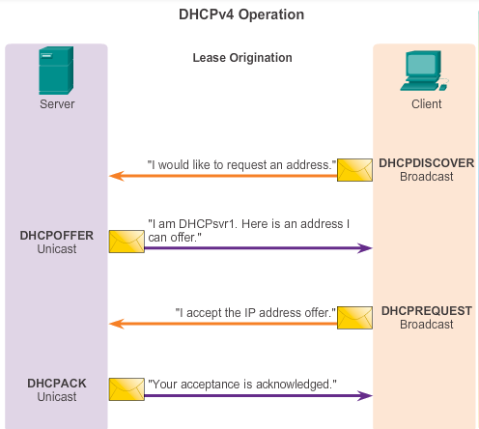
DHCPv4 Operation Introducing DHCPv4
DORA
Notes:
10.1 DHCP v4
10.1.1 DHCPv4 Operation
10.1.1.2 DHCPv4 Operation

Slide 5
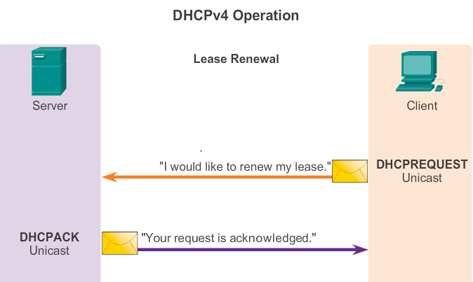
DHCP Lease Renewal
DHCP Request (DHCPREQUEST)
When the lease has expired, the client sends a DHCPREQUEST message directly to the DHCPv4 server that originally offered the IPv4 address..
DHCP Acknowledgment (DHCPACK)
On receiving the DHCPREQUEST message, the server verifies the lease information by returning a DHCPACK.

Slide 6
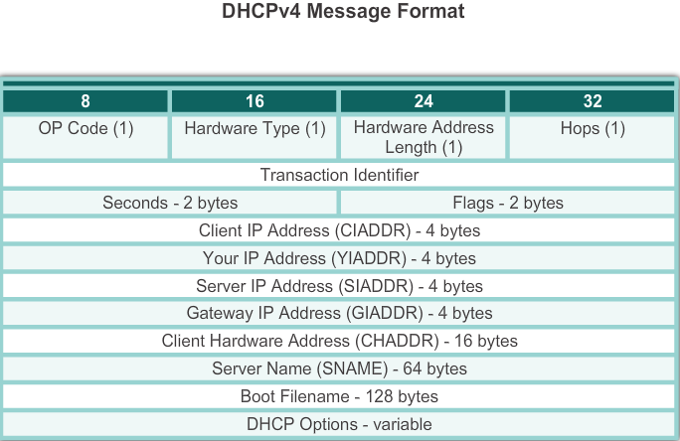
DHCPv4 Operation DHCPv4 Message Format
Notes:
10.1 DHCP v4
10.1.1 DHCPv4 Operation
10.1.1.3Introducing DHCPv4

Slide 7
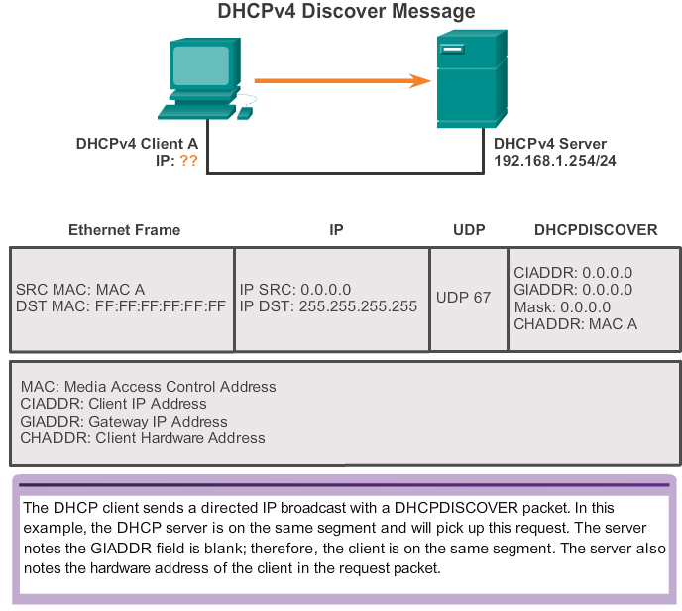
DHCPv4 Operation DHCPv4 Discover Messages
Notes:
10.1 DHCP v4
10.1.1 DHCPv4 Operation
10.1.1.4 DHCPv4 Discover and Offer Messages

Slide 8
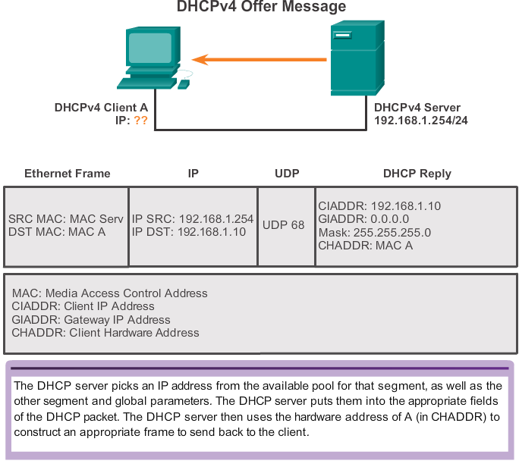
DHCPv4 Operation DHCPv4 Offer Messages

Slide 9
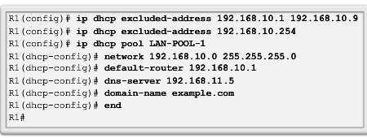
DHCPv4 Operation Configuring a DHCPv4 Server
A Cisco router running Cisco IOS software can be configured to act as a DHCPv4 server. To set up DHCP
1.Exclude addresses from the pool.
2. Set up DHCP pool name
3. Configuring Specific Tasks –define range of addresses and subnet mask. Use default-router command for default gateway. Optional items that can be included in pool – dns server, domain-name
To disable dhcp - no service dhcp
Notes:
10.1 DHCP v4
10.1.1 DHCPv4 Operation
10.1.2.1 Configuring a DHCPv4 Server

Slide 10
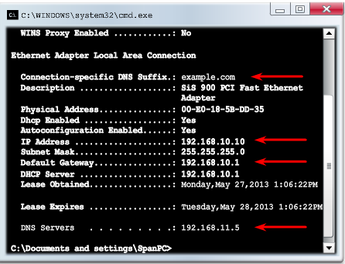
DHCPv4 Operation Verifying a DHCPv4 Server
Commands to verify DHCP
show running-config | section dhcp
show ip dhcp binding
show ip dhcp server statistics
On the PC –issue the ipconfig /all command
Notes:
10.1 DHCP v4
10.1.2Configure DHCPv4 Server
10.1.2.2 Verifying a DHCPv4 Server

Slide 11
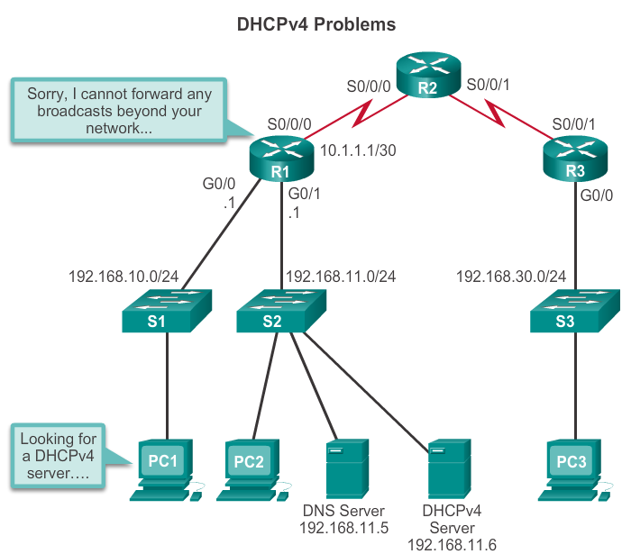
DHCPv4 Operation DHCPv4 Relay
In a large networks, enterprise servers are usually located in a server farm. These servers may provide DHCP, DNS, TFTP, and FTP services for the network.
Network clients are not typically on the same subnet as those servers. In order to locate the servers and receive services, clients often use broadcast messages.
As a solution to this problem, an administrator can add DHCPv4 servers on all the subnets. However, creates additional cost and administrative overhead.
A better solution is to configure a Cisco IOS helper address. This solution enables a router to forward DHCPv4 broadcasts to the DHCPv4 server

Slide 12
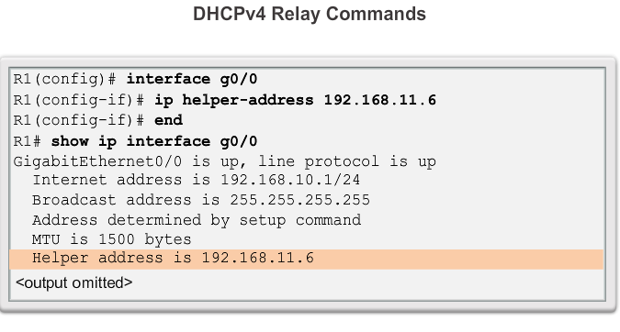
DHCPv4 Operation DHCPv4 Relay
Using an IP helper address enables a router to forward DHCPv4 broadcasts to the DHCPv4 server. Acting as a relay.
Address of the DHCP Server
Notes:
10.1 DHCP v4
10.1.2Configure DHCPv4 Server
10.1.2.3 DHCPv4 Relay

Slide 13
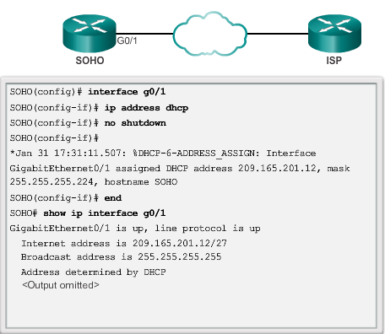
Configuring a DHCPv4 client Configuring a Router as DHCPv4 client
Sometimes, Cisco routers in small office/home office (SOHO) and branch sites have to be configured as DHCPv4 clients in a similar manner to client computers.
Notes:
10.1 DHCP v4
10.1.3 Configuring a DHCPv4 client
10.1.3.1 Configuring a Router as DHCPv4 Client

Slide 14
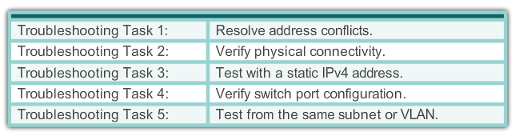
Troubleshoot DHCPv4 Troubleshooting Tasks
DHCPv4 problems can arise for a multitude of reasons, such as software defects in operating systems, NIC drivers, or DHCP relay agents, but the most common are configuration issues.
Because of the number of potentially problematic areas, a systematic approach to troubleshooting is required, as shown below.
Notes:
10.1 Managing IOS System Files
10.1.4 Troubleshoot DHCPv4
10.1.4.1 Troubleshooting Tasks

Slide 15
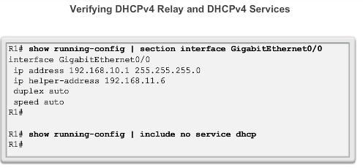
Troubleshoot DHCPv4 Verify Router DHCPv4 Configuration
Notes:
10.1 Managing IOS System Files
10.1.4 Troubleshoot DHCPv4
10.1.4.2 Verify Router DHCPv4 Configuration

Slide 16
Troubleshooting Task 1: Resolve IPv4 Address Conflicts
An IPv4 address lease can expire on a client still connected to a network. If the client does not renew the lease, the DHCPv4 server can reassign that IPv4 address to another client.The situation then arises where two clients are using the same IPv4 address, creating a conflict.
The show ip dhcp conflict command displays all address conflicts recorded by the DHCPv4 server. This output displays IP addresses that have conflicts with the DHCP server.
The server uses the ping command to detect clients. The client uses Address Resolution Protocol (ARP) to detect conflicts.
If an address conflict is detected, the address is removed from the pool and not assigned until an administrator resolves the conflict.
.

Slide 17
Troubleshooting Task 2: Verify Physical Connectivity
First, use the show interface interface command to confirm that the router interface acting as the default gateway for the client is operational.
If the state of the interface is anything other than up, the port does not pass traffic, including DHCP client requests.
Troubleshooting Task 3: Test Connectivity using a Static IP Address
When troubleshooting any DHCPv4 issue, verify network connectivity by configuring a static IPv4 address information on a client workstation. If the workstation is unable to reach network resources with a statically configured IPv4 address, the root cause of the problem is not DHCPv4. At this point, network connectivity troubleshooting is required.

Slide 18
Troubleshooting Task 4: Verify Switch Port Configuration
If the DHCPv4 client is unable to obtain an IPv4 address from the DHCPv4 server on startup, attempt to obtain an IPv4 address from the DHCPv4 server by manually forcing the client to send a DHCPv4 request. (ipconfig /renew)
If there is a switch between the client and the DHCPv4 server, and the client is unable to obtain the DHCP configuration, switch port configuration issues may be the cause. These causes may include issues from trunking, STP. PortFast configuration and edge port configurations resolve the most common DHCPv4 client issues that occur with an initial installation of a Cisco switch.

Slide 19
Troubleshooting Task 5: Test DHCPv4 Operation on the Same Subnet or VLAN
It is important to distinguish whether DHCPv4 is functioning correctly when the client is on the same subnet or VLAN as the DHCPv4 server. If DHCPv4 is working correctly when the client is on the same subnet or VLAN, the problem may be the DHCP relay agent.
If the problem persists even with testing DHCPv4 on the same subnet or VLAN as the DHCPv4 server, the problem may actually be with the DHCPv4 server.

Slide 20
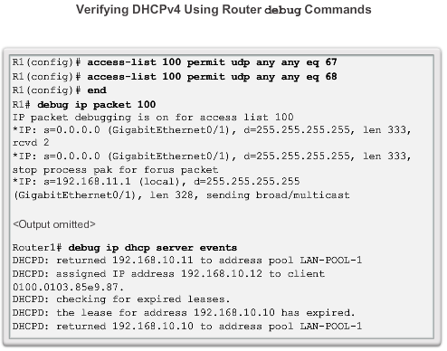
Troubleshoot DHCPv4 Debugging DHCPv4
On routers configured as DHCPv4 servers, the DHCPv4 process fails if the router is not receiving requests from the client.
As a troubleshooting task, verify that the router is receiving the DHCPv4 request from the client.
This troubleshooting step involves configuring an ACL for debugging output.
Notes:
10.1.4 Troubleshoot DHCPv4
10.1.4.3 Debugging DHCPv4

Slide 21
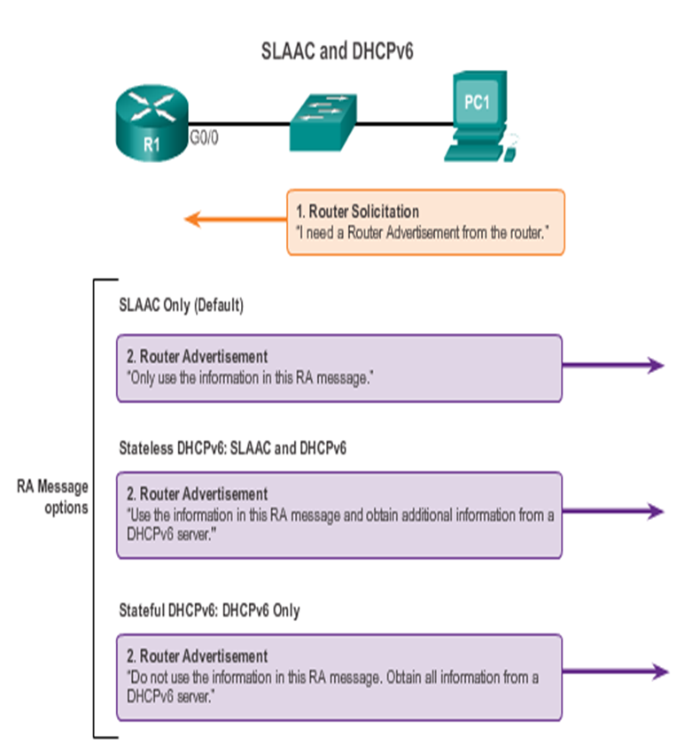
IPv6 Configuration Options
The decision of whether a client is configured to obtain its IPv6 addressing information automatically using SLAAC, DHCPv6, or a combination of both depends on the settings within the RA message. ICMPv6 RA messages contain two flags to indicate which option the client should use. The two flags are the Managed Address Configuration flag (M flag) and the Other Configuration flag (O flag).
Using different combinations of the M and O flags, RA messages have one of three addressing options for the IPv6 device, as shown in the figure:
SLAAC (Router Advertisement only)
Stateless + DHCPv6 (Router Advertisement and DHCPv6)
Stateful DHCPv6 (DHCPv6 only)

Slide 22
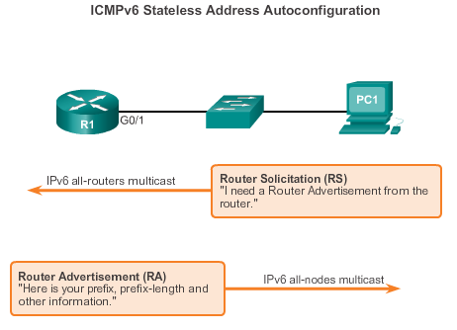
SLAAC and DHCPv6 Stateless Address Autoconfiguration (SLAAC)
Similar to IPv4, IPv6 global unicast addresses can be configured manually or dynamically.
However, there are two methods in which IPv6 global unicast addresses can be assigned dynamically:
Stateless Address Autoconfiguration (SLAAC), as shown in the figure
Dynamic Host Configuration Protocol for IPv6 (Stateful DHCPv6)
SLAAC is a method in which a device can obtain an IPv6 global unicast address without the services of a DHCPv6 server.
Notes:
10.2 DHCP v6
10.2.1 SLAAC and DHCPv6
10.2.1.1 Stateless Address Autoconfiguration (SLAAC)

Slide 23
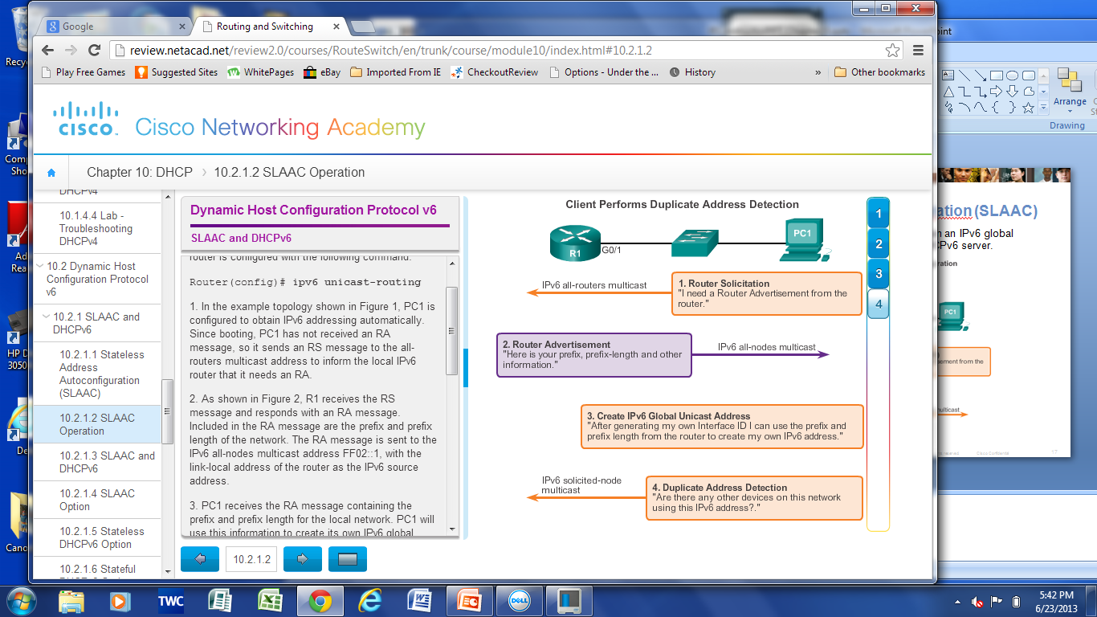
SLAAC and DHCPv6 SLAAC Operation
R1 receives the RS message and responds with an RA message. Included in the RA message are the prefix and prefix length of the network.
PC1 it sends an RS message to the all-routers multicast address to inform the local IPv6 router that it needs an RA.
PC1 will use this information to create its own IPv6 global unicast address. PC1 now has a 64-bit network prefix, but needs a 64-bit Interface ID.
PC1 can create its own unique IID: EUI-64 or Randomly generated
PC1 can create a 128-bit IPv6 global unicast PC1 will use the link-local address of the router as its IPv6 default gateway address.
Before PC1 can use this newly created IPv6 address it must verify that it is unique. PC1 sends an ICMPv6 NS message with its own address as the target IPv6 address. If no other devices respond with a NA message, then the address is unique and can be used by PC1
Notes:
10.2 DHCP v6
10.2.1 SLAAC and DHCPv6
10.2.1.2 SLAAC Operation

Slide 24
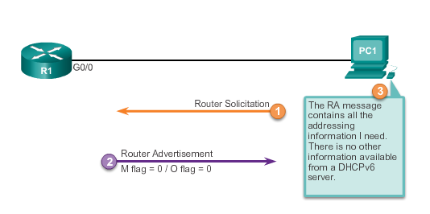
SLAAC and DHCPv6 SLAAC Option
Notes:
10.2 DHCP v6
10.2.1 SLAAC and DHCPv6
10.2.1.4 SLAAC Option

Slide 25
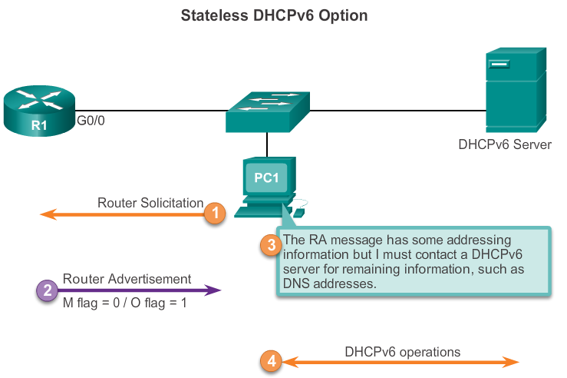
SLAAC and DHCPv6 SLAAC Plus DHCPv6
Notes:
10.2 DHCP v6
10.2.1 SLAAC and DHCPv6
10.2.1.3 SLAAC and DHCPv6

Slide 26
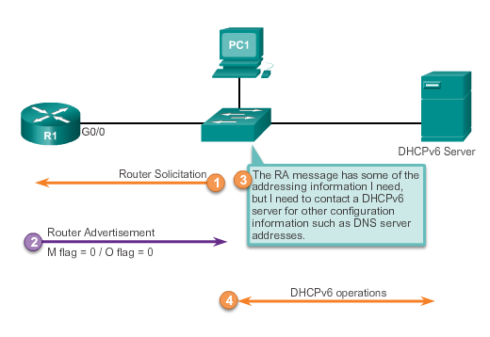
SLAAC and DHCPv6 Stateless DHCP Option
The stateless DHCPv6 option informs the client to use the information in the RA message for addressing, but additional configuration parameters are available from a DHCPv6 server.
Notes:
10.2 DHCP v6
10.2.1 SLAAC and DHCPv6
10.2.1.5 Stateless DHCP Option

Slide 27
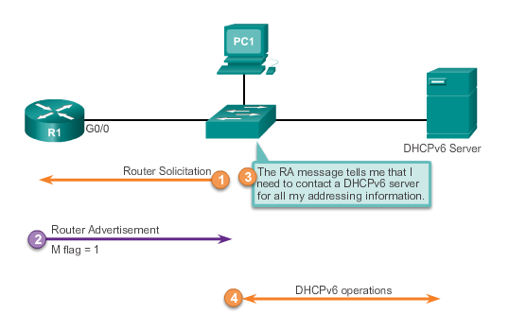
SLAAC and DHCPv6 Stateful DHCP Option
This option is the most similar to DHCPv4. In this case, the RA message informs the client not to use the information in the RA message. All addressing information and configuration information must be obtained from a stateful DHCPv6 server
Notes:
10.2 DHCP v6
10.2.1 SLAAC and DHCPv6
10.2.1.6 Stateful DHCP Option

Slide 28
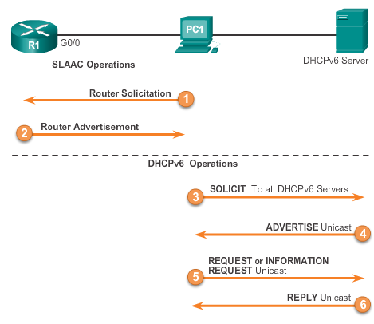
SLAAC and DHCPv6 DHCPv6 Operations
Notes:
10.2 DHCP v6
10.2.1 SLAAC and DHCPv6
10.2.1.7 DHCPv6 Operations

Slide 29
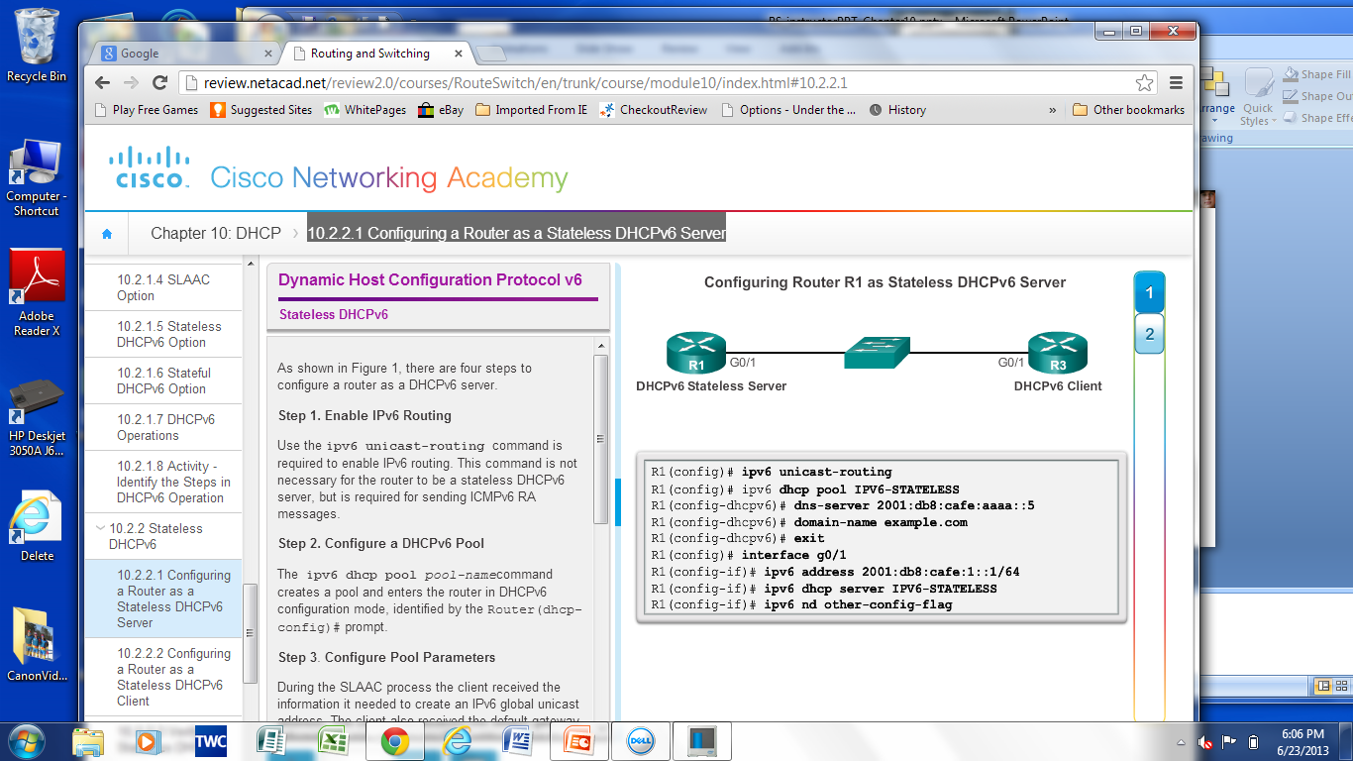
Stateless DHCPv6 Configuring a Router as a Stateless DHCPv6 Server
The O flag needs to be changed from 0 to 1 using the interface command ipv6 nd other-config-flag
RA messages sent on this interface indicate that additional information is available from a stateless DHCPv6 server.
Notes:
10.2 DHCP v6
10.2.2 Stateless DHCPv6
10.2.2.1 Configuring a Router as a Stateless DHCPv6 Server

Slide 30
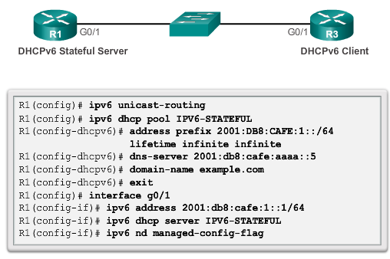
Stateful DHCPv6 Configuring a Router as a Stateful DHCPv6 Server
The M flag needs to be changed from 0 to 1 using the interface command:
ipv6 nd managed-config-flag.
This informs the device not to use SLAAC but to obtain IPv6 addressing and all configuration parameters from a stateful DHCPv6 server.
Notes:
10.2 DHCP v6
10.2.3 Stateful DHCPv6 Server
10.2.3.1 Configuring a Router as a Stateful DHCPv6 Server

Slide 31
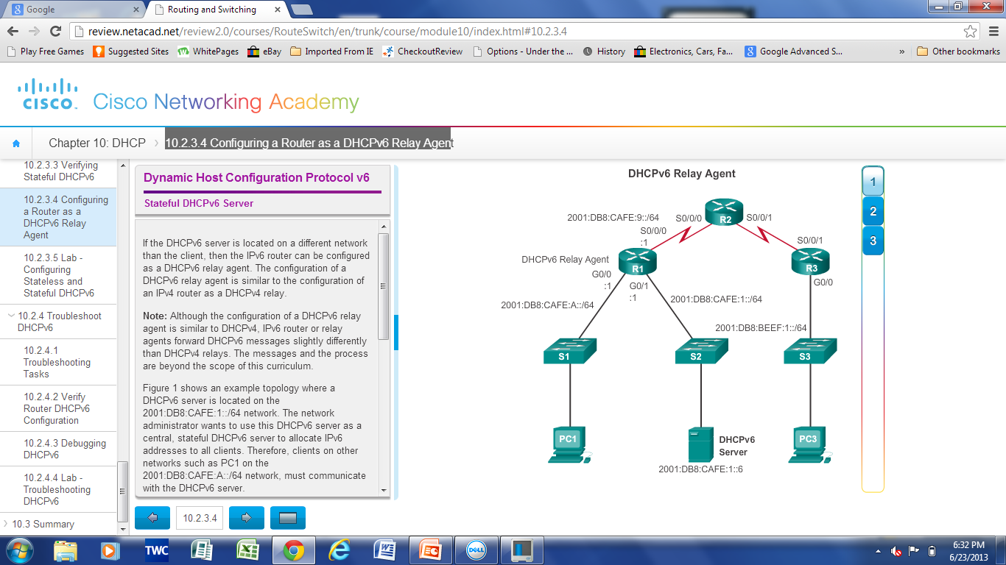
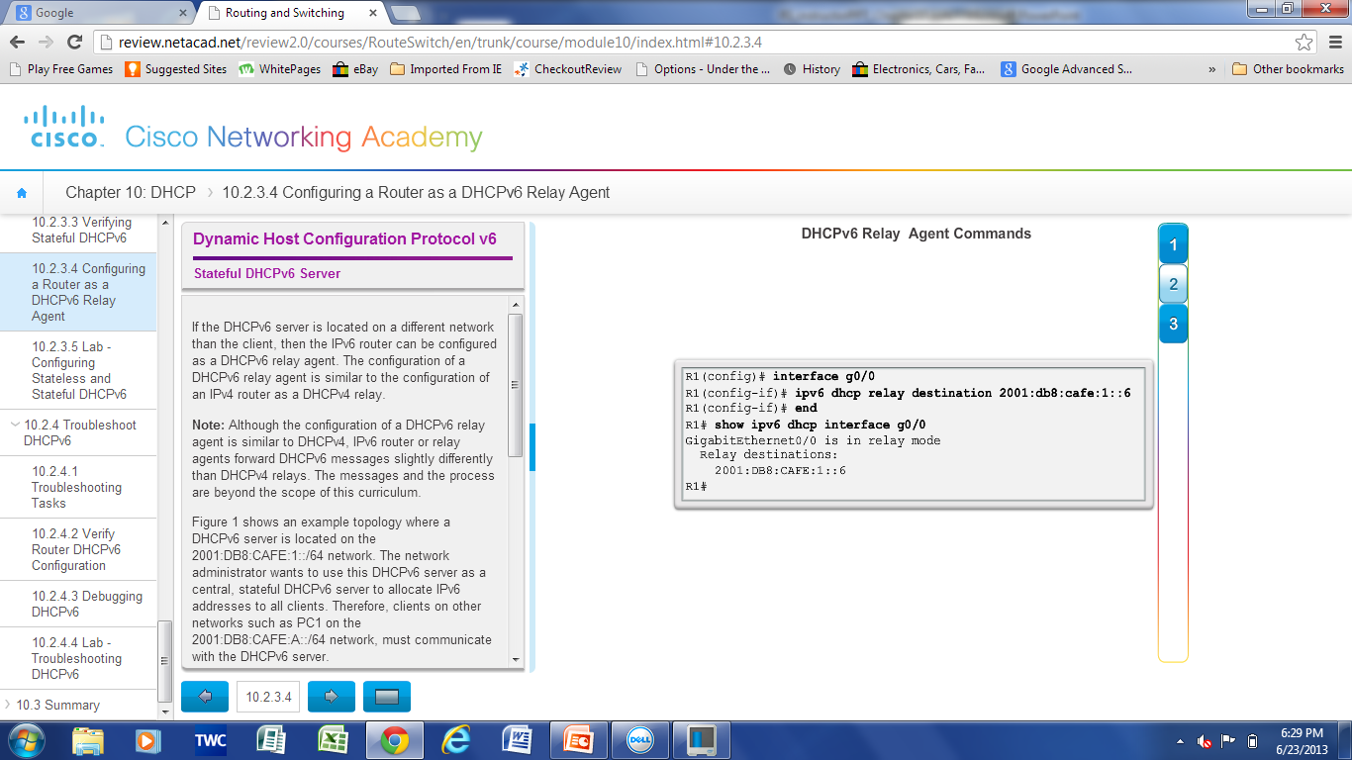
Stateful DHCPv6 Config a Router as a Stateful DHCPv6 Relay Agent
If the DHCPv6 server is located on a different network than the client, then the IPv6 router can be configured as a DHCPv6 relay agent. The configuration of a DHCPv6 relay agent is similar to the configuration of an IPv4 router as a DHCPv4 relay.
Notes:
10.2 DHCP v6
10.2.3 Stateful DHCPv6 Server
10.2.3.4 Configuring a Router as a DHCPv6 Relay Agent

Slide 32
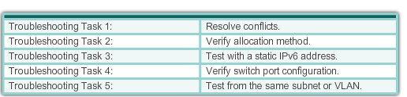
Troubleshooting DHCPv6 Troubleshooting Tasks
Notes:
10.2 DHCP v6
10.2.4 Troubleshoot DHCPv6
10.2.4.1 Troubleshooting Tasks

Slide 33
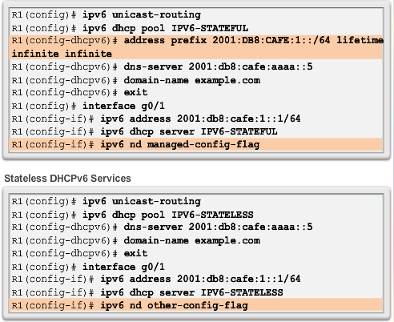
Troubleshooting DHCPv6 Verify Router DHCPv6 Configuration
Notes:
10.2 DHCP v6
10.2.4 Troubleshoot DHCPv6
10.2.4.2 Verify Router DHCPv6 Configuration

Slide 34
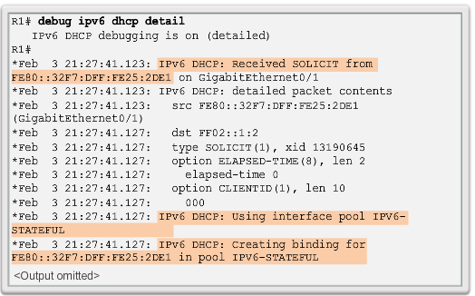
Troubleshooting DHCPv6 Debugging DHCPv6
Notes:
10.2 DHCP v6
10.2.4 Troubleshoot DHCPv6
10.2.4.3 Debugging DHCPv6

Slide 35


